Slide 1
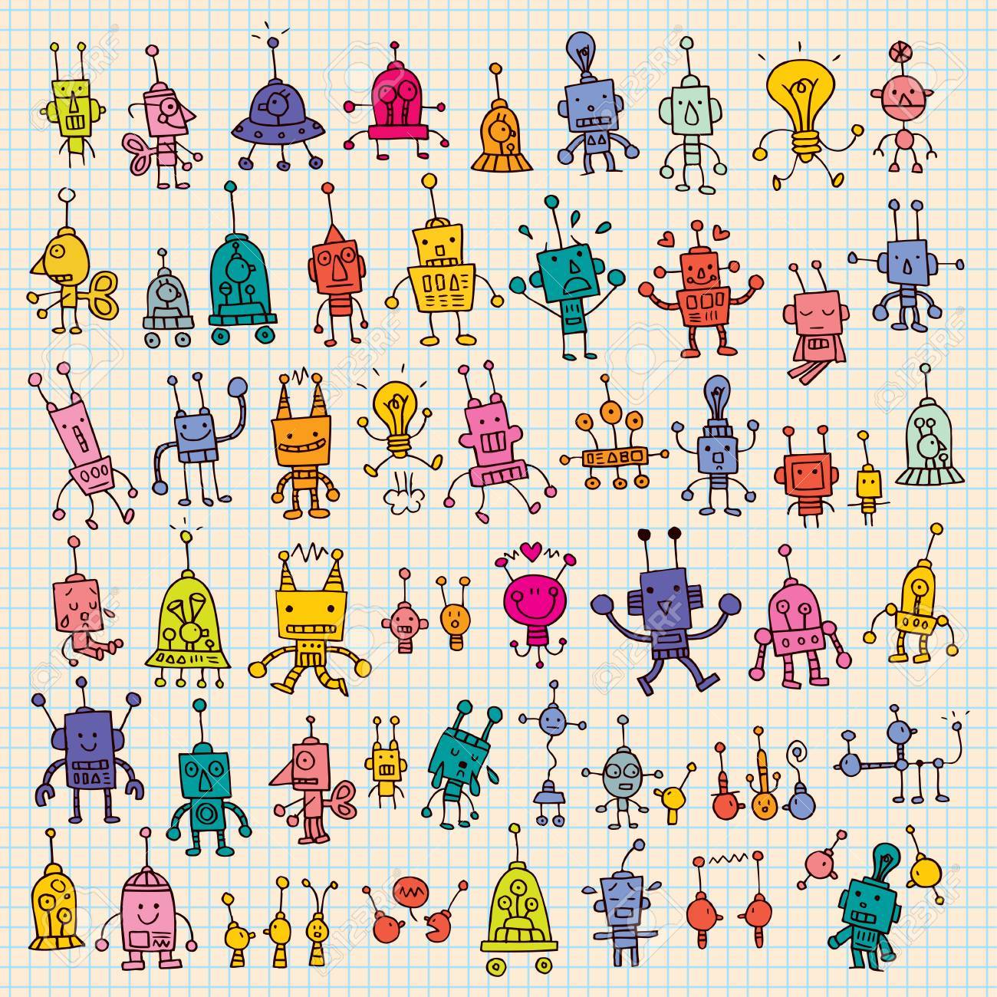
Enter our Children’s Short Story Competition and be in with a chance to win £100!

Slide 2
Stories must be on the theme of ‘Inventions’ and can be in any genre you like! The more unique and creative the better!

Slide 3
Stories must have some link to North Notts and can be no longer than 777 words! (To commemorate the completition of Chesterfield Canal in 1777!)

Slide 4
You must be aged between 7-14 at the time of entering. If you are older, then take a look at the competitions for 15+!

Slide 5
Finalists will be invited to the Awards Ceremony at the new in September!

Slide 6
Prizes up for grabs… 1st - £100 2nd - £50 3rd - £25

Slide 7
So what are you waiting for? Get writing! Full rules of entry on www.nnlf.org.uk or follow us on social media @nnlitfest

